Slide 1
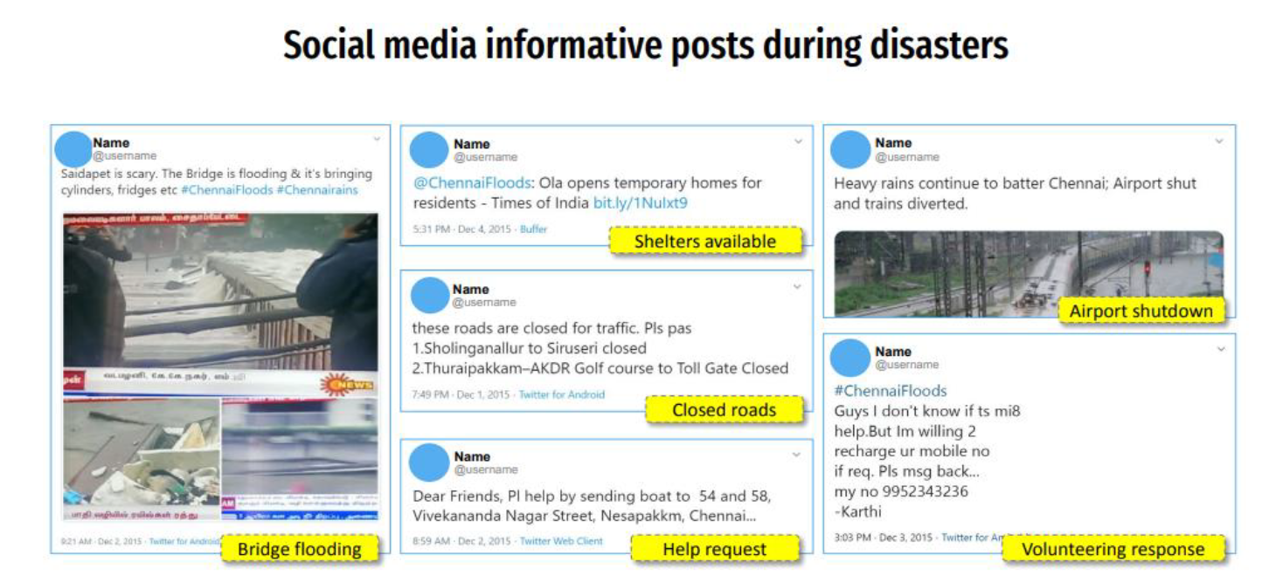
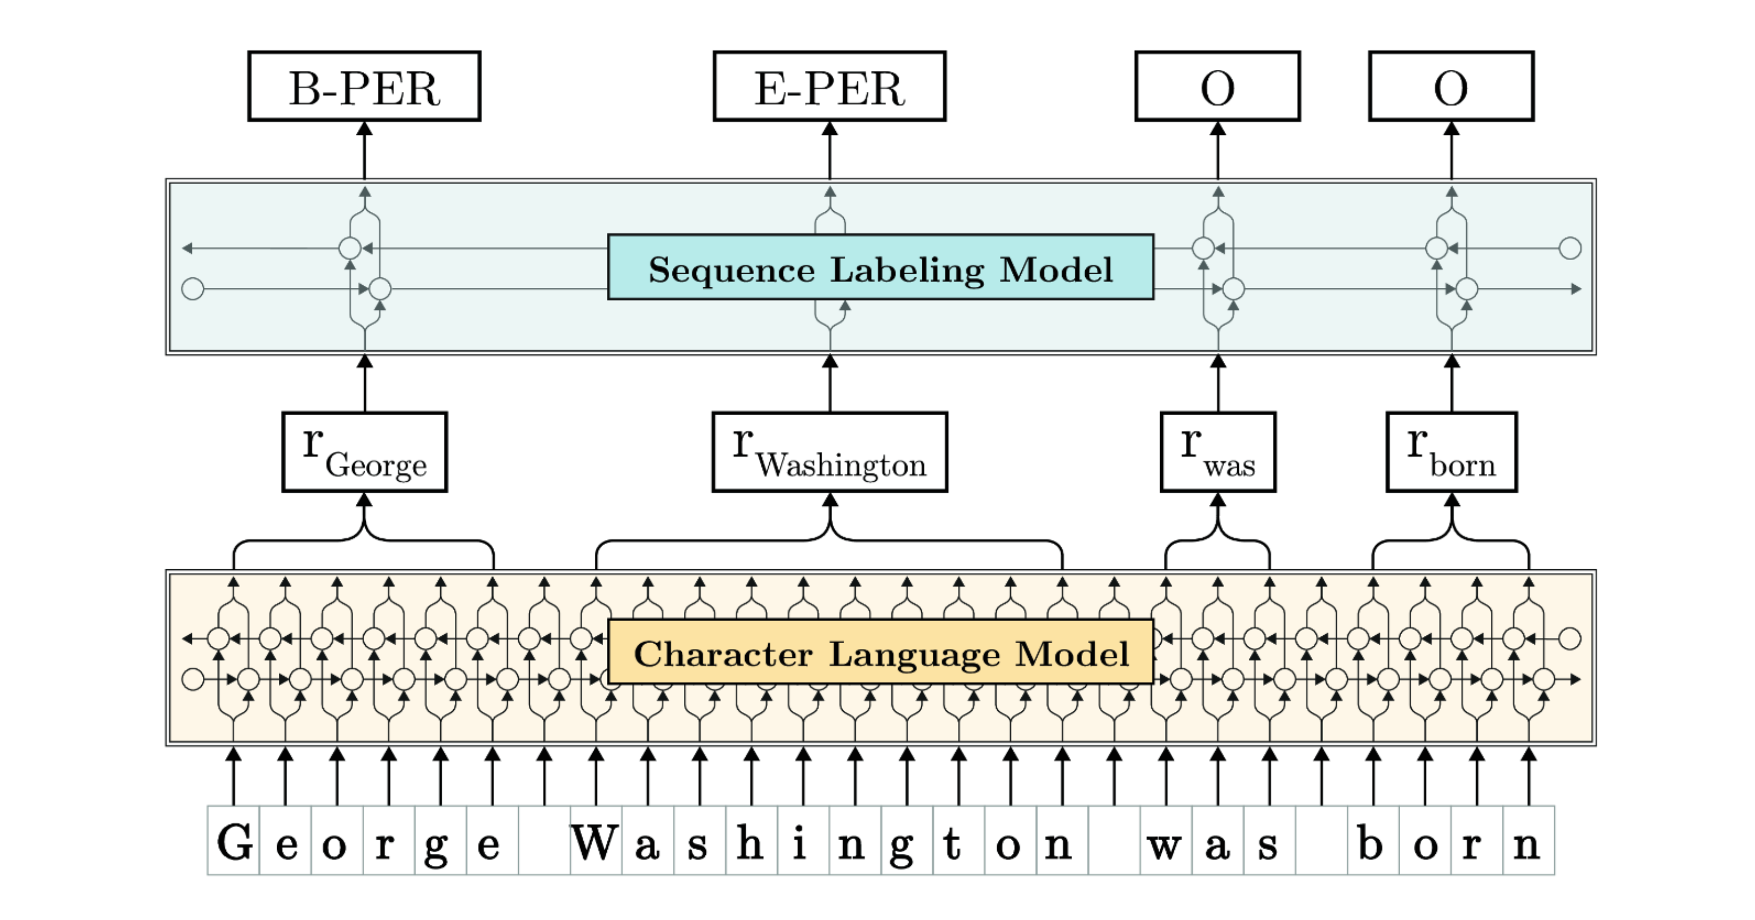
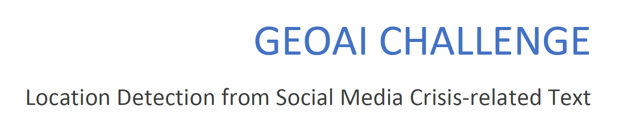
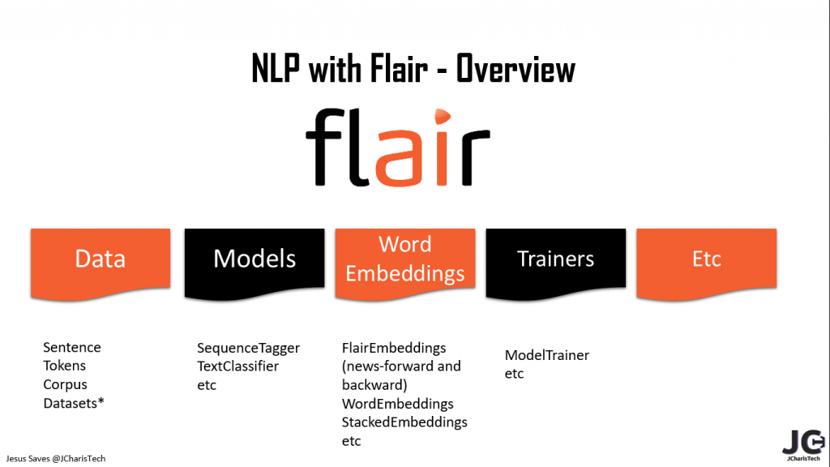


Slide 2
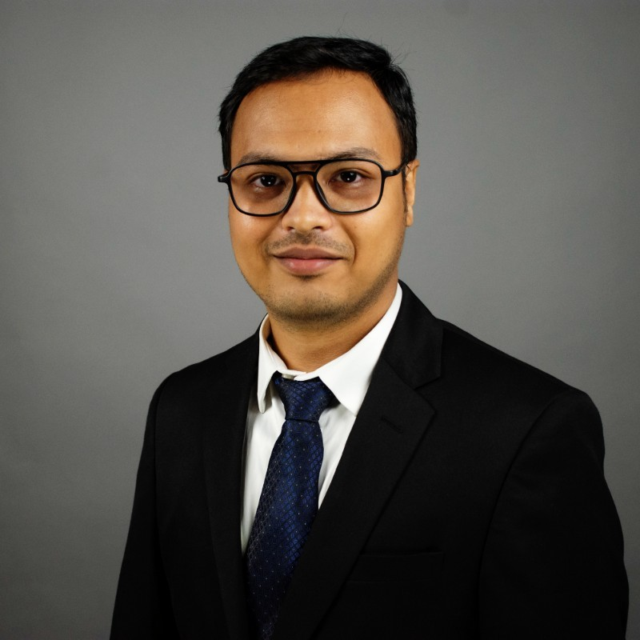
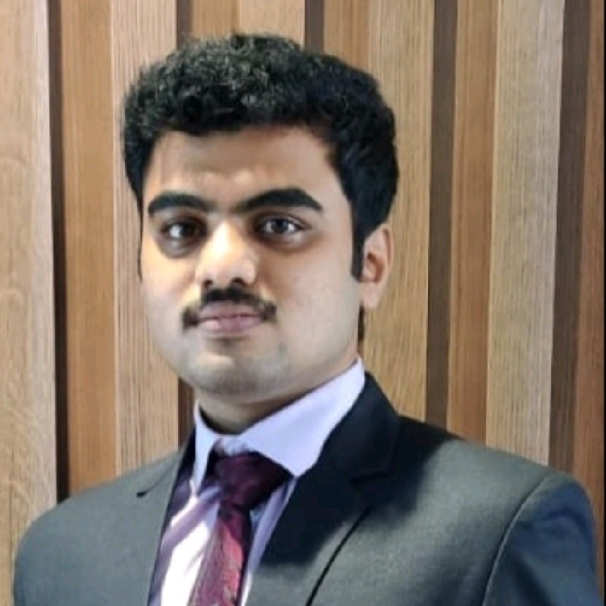
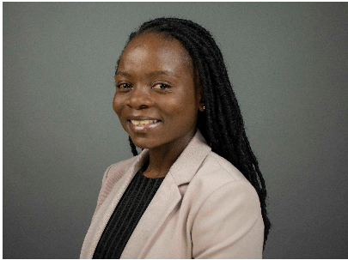
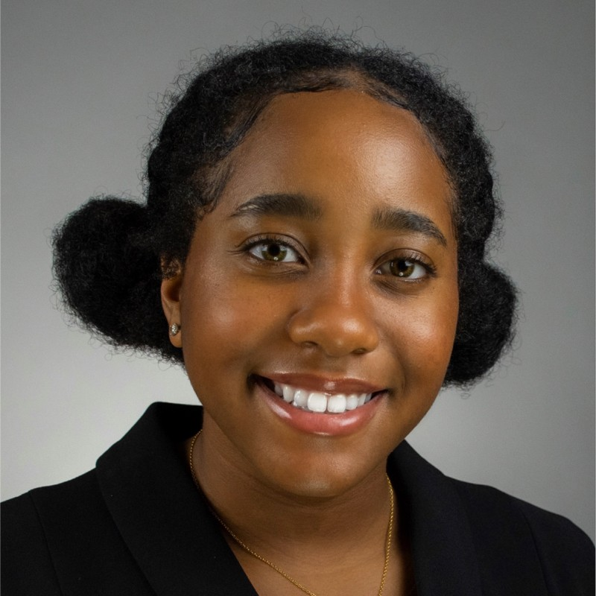
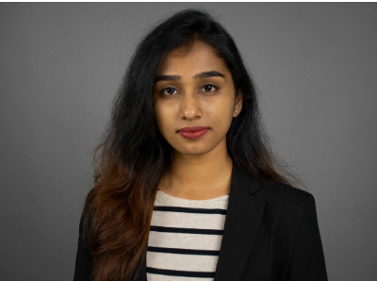
Patterns
Saswata Rautray
Prathamesh Kulkarni
Noreen Chihora
Tejaswi Maruthi
Becka Cammon

Slide 3
Mission Statement
Patterns
Patterns
About ourselves
Using Machine Learning to solve real world problems and make earth a better place to live.
We are team patterns, a team of ML enthusiastic second-year student of MS Business Analytics & Data Science at Oklahoma State University.
We have keen interest in NLP and text analytics.
Notes:
We are a unique 3D printing carbon fiber bike company producing custom fit bikes for our customers instead of a one size fits all

Slide 4

Agenda
Introduction
Methodology
Evaluation
Takeaway messages

Slide 5
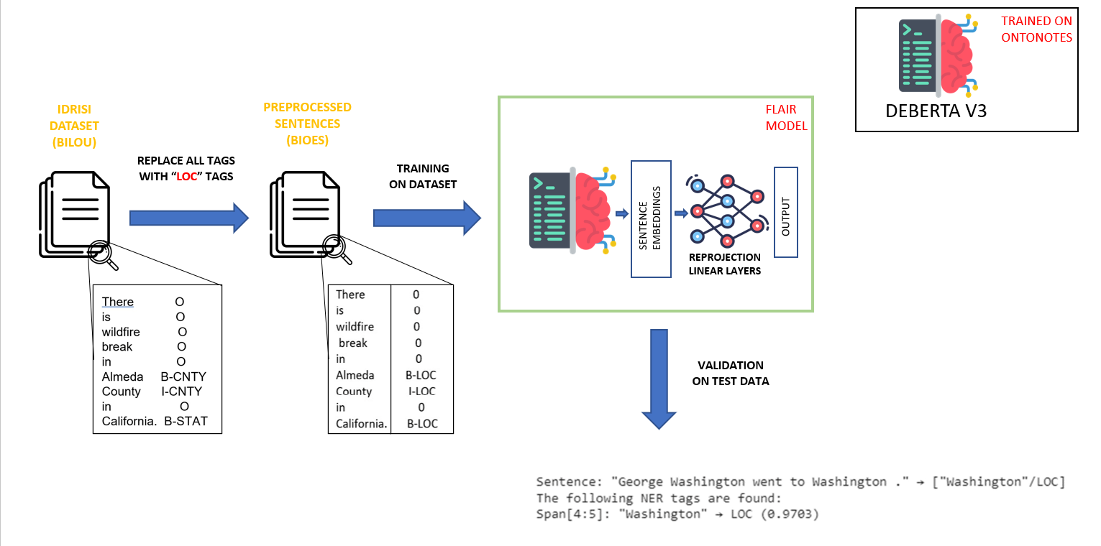
Methodology

Slide 6
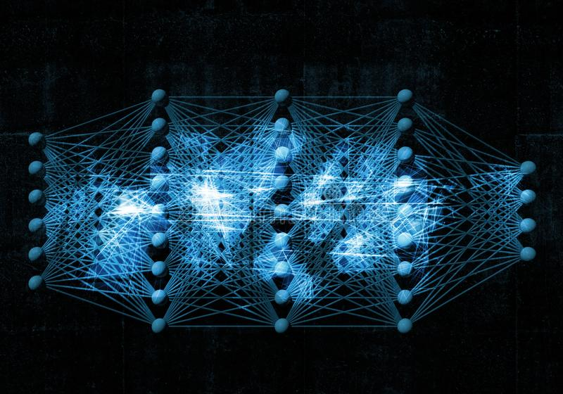
Methodology
Hypothesis and assumption:-
Our main hypothesis was that transfer learning can better help to tackle challenge of NER task in NLP.
Our assumption was finetuning a pretrained embedding from a bigger corpus would better perform in understanding the context of given sentence.
Type of Method:-
ML based- Flair framework (HuggingFace)

Slide 7

Methodology
Evaluation:-
Programming language:- Python, Colab (GPU-resource)
Preprocessing steps:-
Importing data from IDRISI in GitHub.
Changing the tagging from “BILOU” to “BIOES”.
Changing multiple tags like STAT, CNTY to “LOC”.
LMR model:-
Using the Flair framework from “HuggingFace”.
Deberta V3 pretrained on “OntoNote5”.
Adding a linear layer for reprojecting the embeddings.
Adding a linear layer for feature detection
Optimizing the loss function by using weights.
Off-the-shelf adopted tools:-
Using the easy to use NLP framework from HuggingFace called “Flair”.

Slide 8
Evaluation
Training & Development:-
The pretrained embeddings were used from deberta model that was trained on “OntoNote5”.
Input data Schema:- The input data was from IDRISI-R GitHub
The data format was changed from “BILOU” to “BIOES”.
Only single label “LOC” used for all location.
Total training data 14392 and validation data is 2056.
Model Tuning :-
Hyper parameters:-
learning rate:- 5.0e-6
Reproject embedding:- True
Mini batch size:- 7
Epochs:- 3
Optimizer:- AdamW
Weight decay: - 0.
Hidden state:- 768

Slide 9
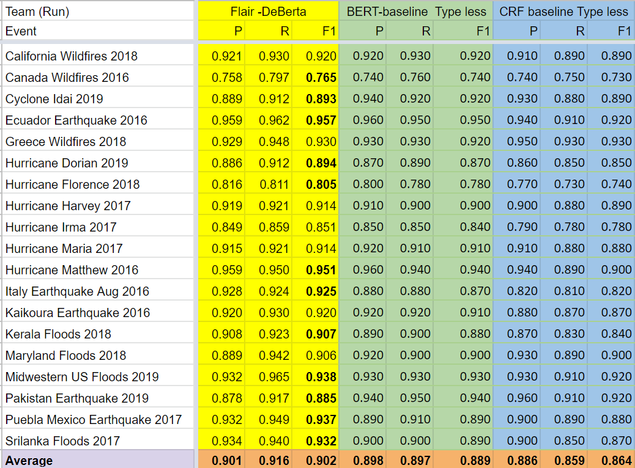
Evaluation
As we can see that Flair based DeBerta model performs well for the disaster-prone dataset.
Flair-DeBerta based model has a F-1 score of 0.902 while BERT and CRF model have score of 0.889 and 0.864.
Therefore, our system better performs than the existing LMR models.

Slide 10
Takeaway Messages
Key Learnings:-
Transfer learning can be used to a great extent effectively in NLP problems like entity recognition, Question answering, text summarization etc.
Flair is great easy to use framework for NLP implementation.
CRF related “Viterbi Loss” function can be outperformed using “CrossEntropy loss” if weights are provided for classes.
Future Scope:-
Can use “ACE” or “automatic concatenation of embedding” for finding best suited embedding in flair. Combination of embeddings is generally said to give better result.
Other hyperparameters can be explored more such as adding a RNN layer for feature input, subtoken_pooling, layers, fine_tuning etc.

Slide 11
Thank you !!

